Slide 1
MUN 10/21
Look at your neighbor aggressively and give em a smile!

Slide 2
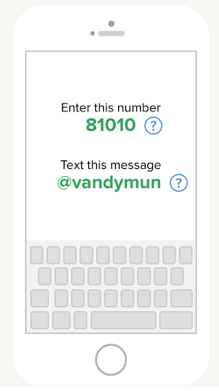
Remind 101

Slide 3
Dues
Dues are $40, you can pay them on the VHS Webstore
they include cost of t-shirt

Slide 4
MUNSA
Date- January 6, 2016
Location- San Antonio
This conference is pretty big, which is good for us!
RAISE YOUR HANDS IN THE AIR AND WAVE EM LIKE YOU JUST DON’T CARE- if you’re interested.

Slide 5
T-Shirts

Slide 6
Parliamentary Procedure
https://www.youtube.com/watch?v=KnVp0070o0s
http://isamunsa.org/parley.html

Slide 7
Uncle Fluffypants
Our inner souls are imbued with deranged admiration for the characteristics so vain that selflessly proclaim to the imminent surroundings our sheer incapability to look into the soul and see but things to see.

